Slide 1
Wikidata.lib
BP2013N2
03.06.2014

Slide 2
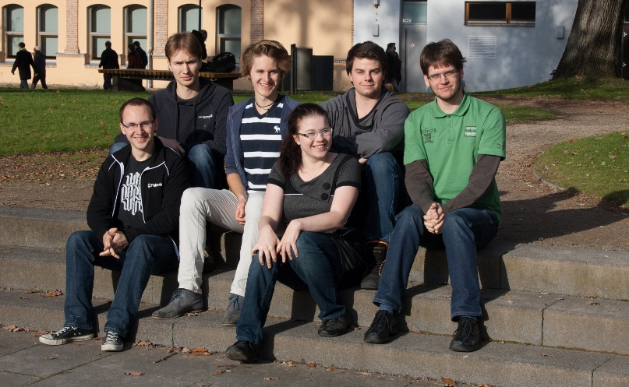
Sebastian Brückner
Christian Dullweber
Felix Niemeyer
Virginia Weidhaas
Moritz Finke
Alexander Lehmann

Slide 3
Project
Our partner: Wikimedia Germany, responsible for the development of Wikidata
Our task: improve access to Wikidata
Hangout meeting once a week
Work from the WMDE office in Berlin
Communication via mailing lists and IRC

Slide 4
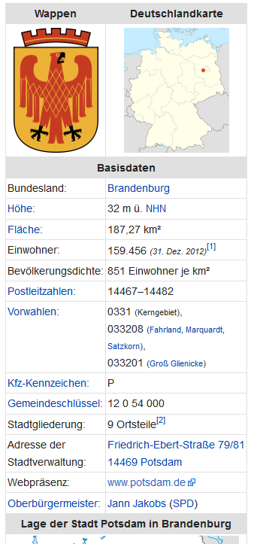
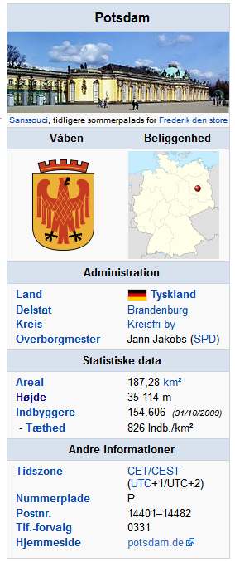
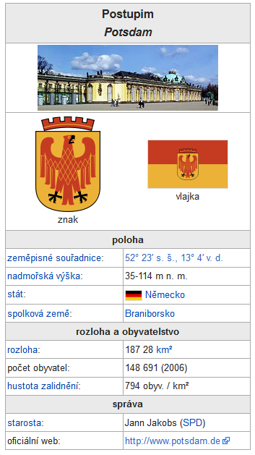

Slide 5
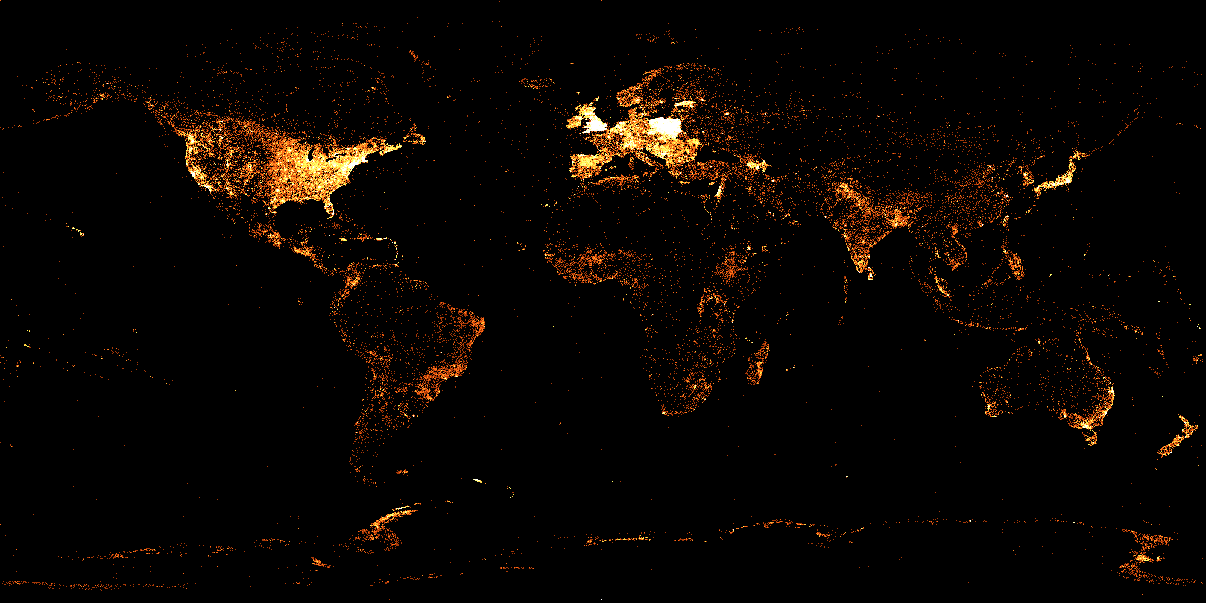
English
Notes:
geo-tagged articles

Slide 6
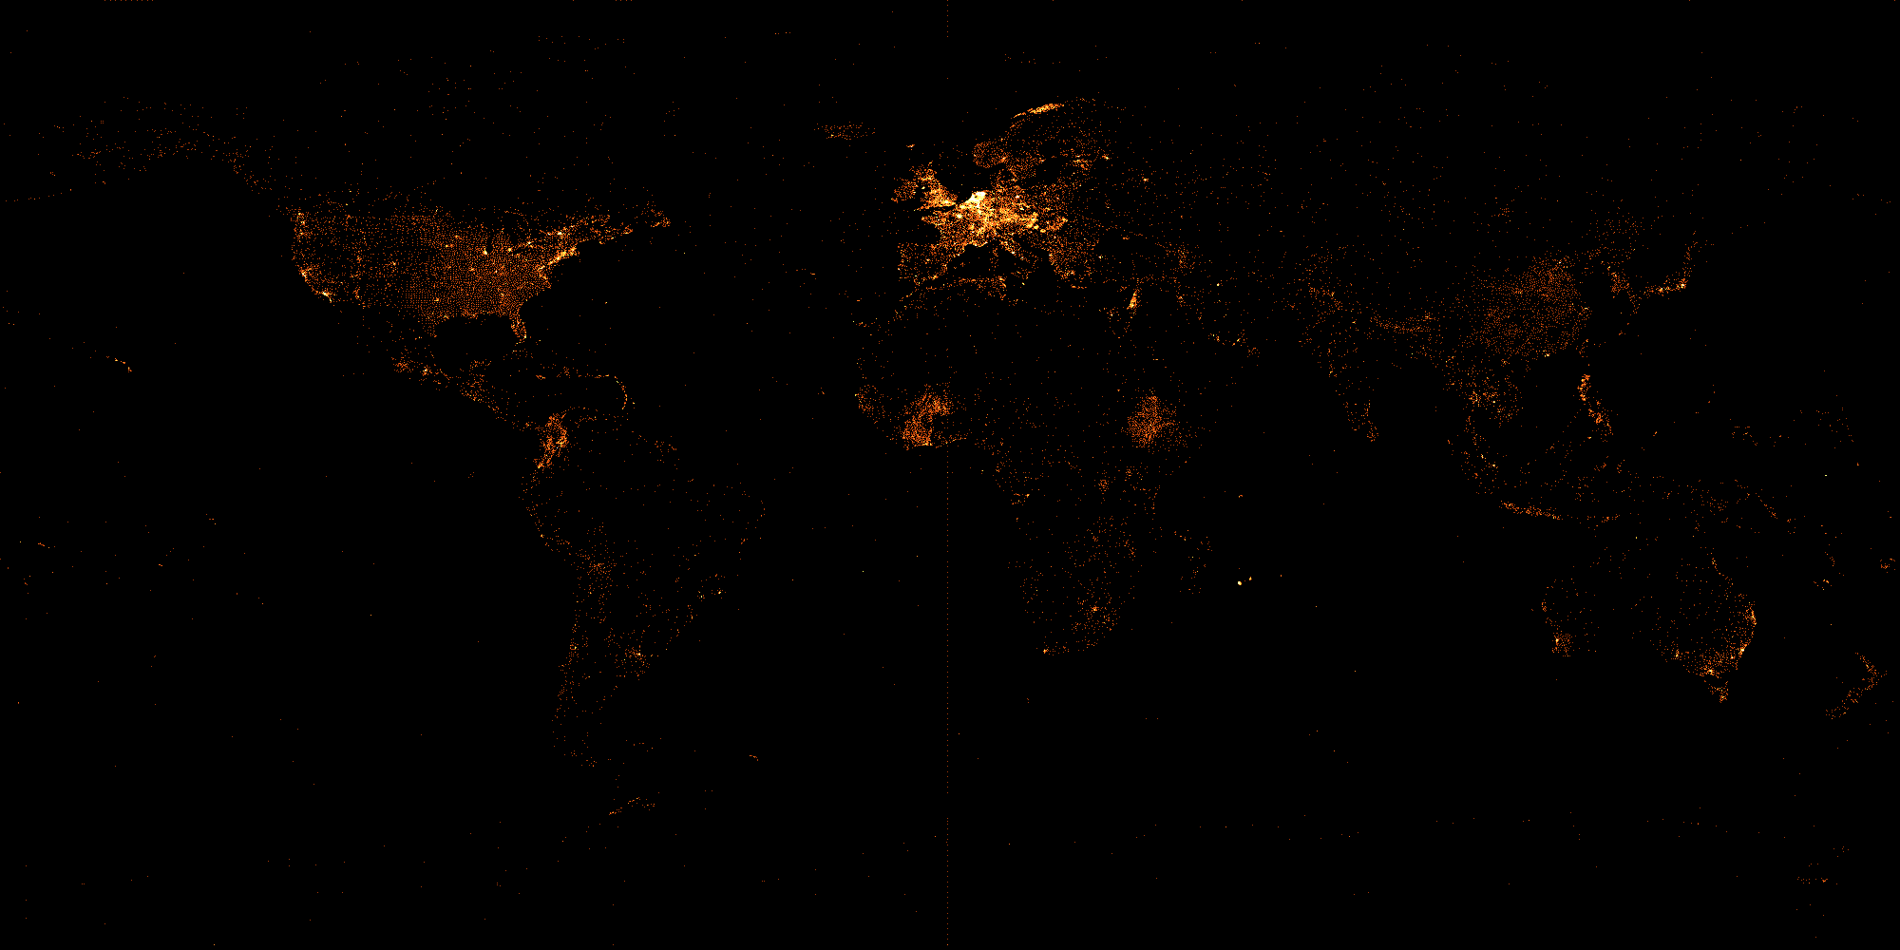
French

Slide 7
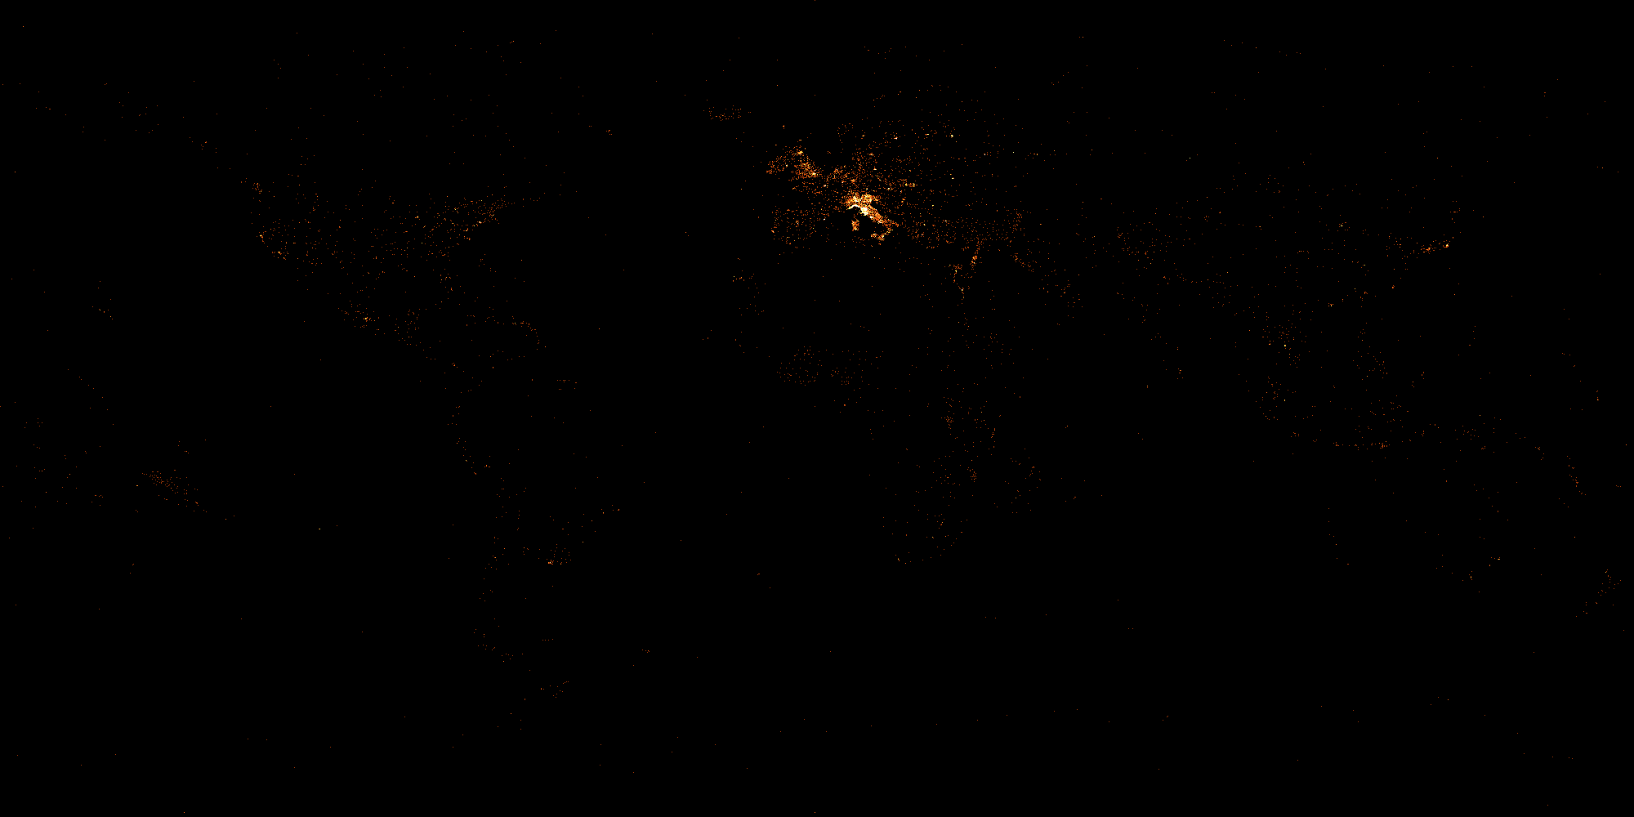
Italian

Slide 8
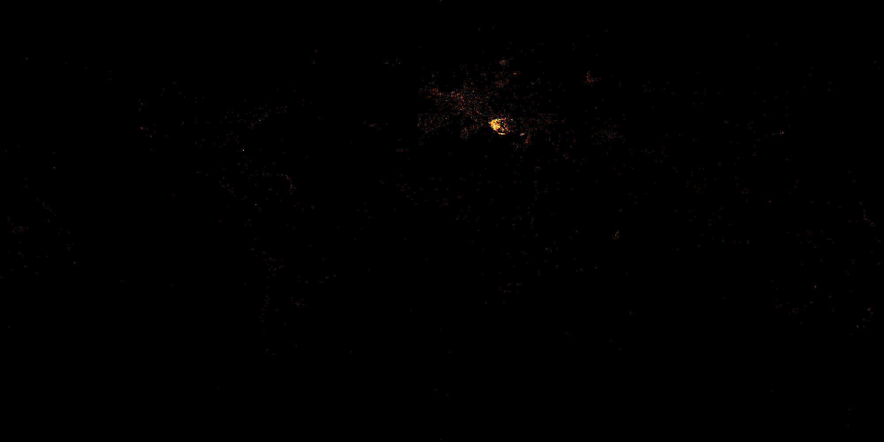
Greek

Slide 9
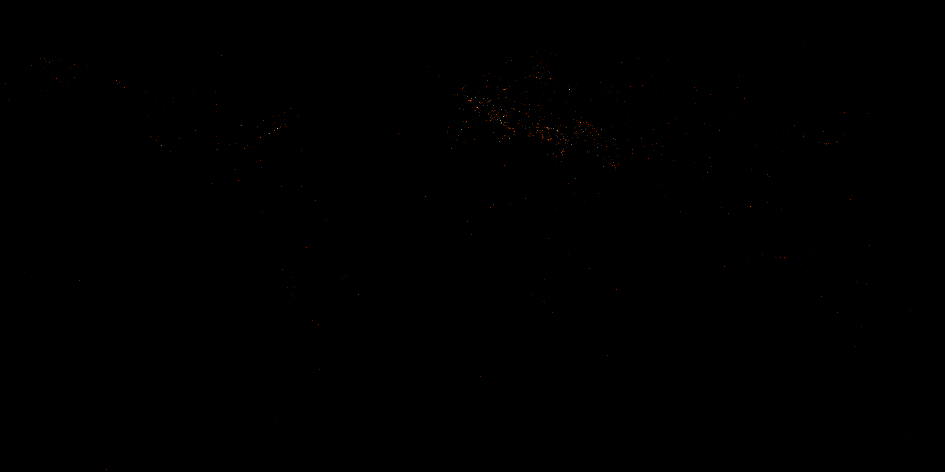
Turkish

Slide 10
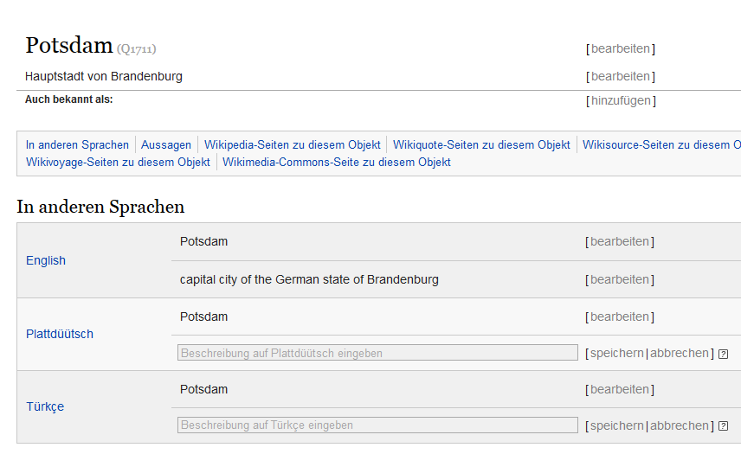

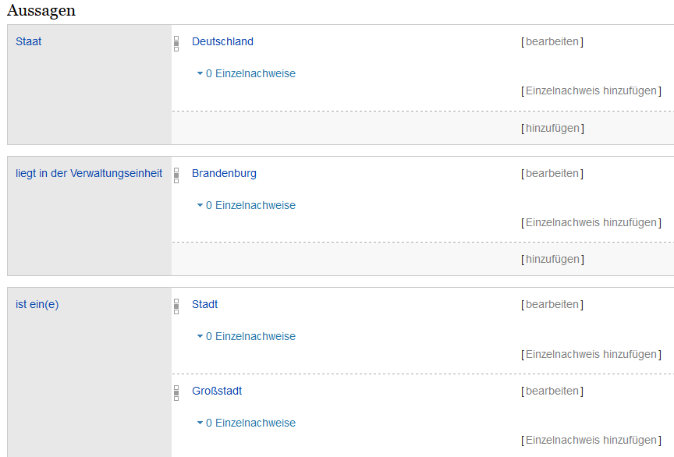

Slide 12

Intelligent Forms
Demo
Notes:
Auf UI hinweisen, im Vergleich zum alten

Slide 13
Workflow
XML/JSON Dump
Feature CSV
PHP Suggester
Suggestions
Dump parser
MySQL Table
Calculate Correlations

Slide 14
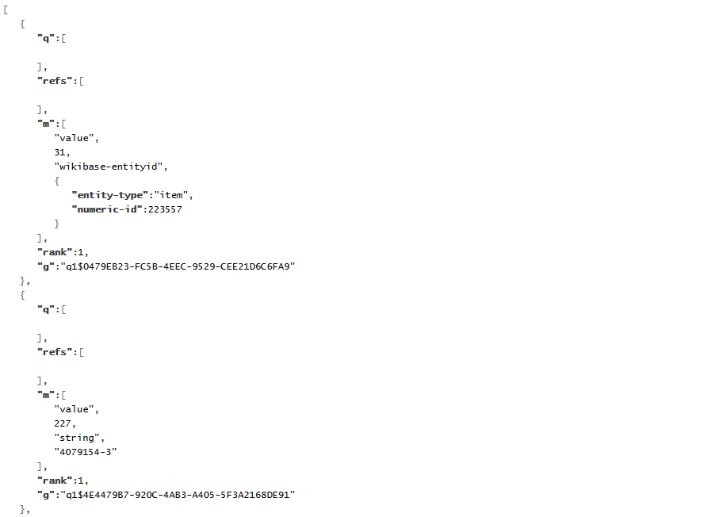
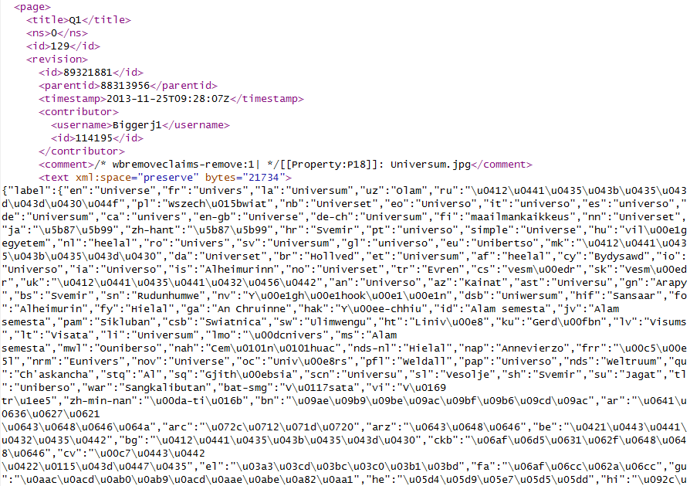
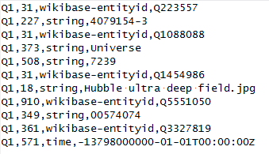
Workflow
XML/JSON Dump
Feature CSV
PHP Suggester
Suggestions
Dump parser
MySQL Table
Calculate Correlations
XML Dump (25GB)
Contains all Wikidata pages and JSON data in the <text> tag
Convert to CSV
Python
XML Stream Parser (xml.etree.cElementTree)
JSON Parser (ujson)
30minutes
CSV (1.7GB)
Q1,31,wikibase-entityid,Q223557
Entity: Q1 (Universe)
Property: 31 (instance of)
Property Type: wikibase-entityid
Value: Q223557 (Physical Object)

Slide 15
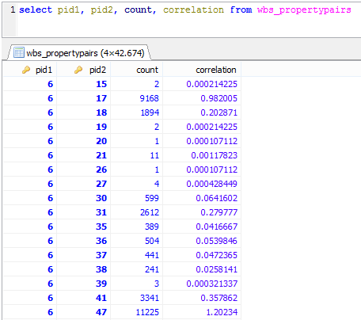
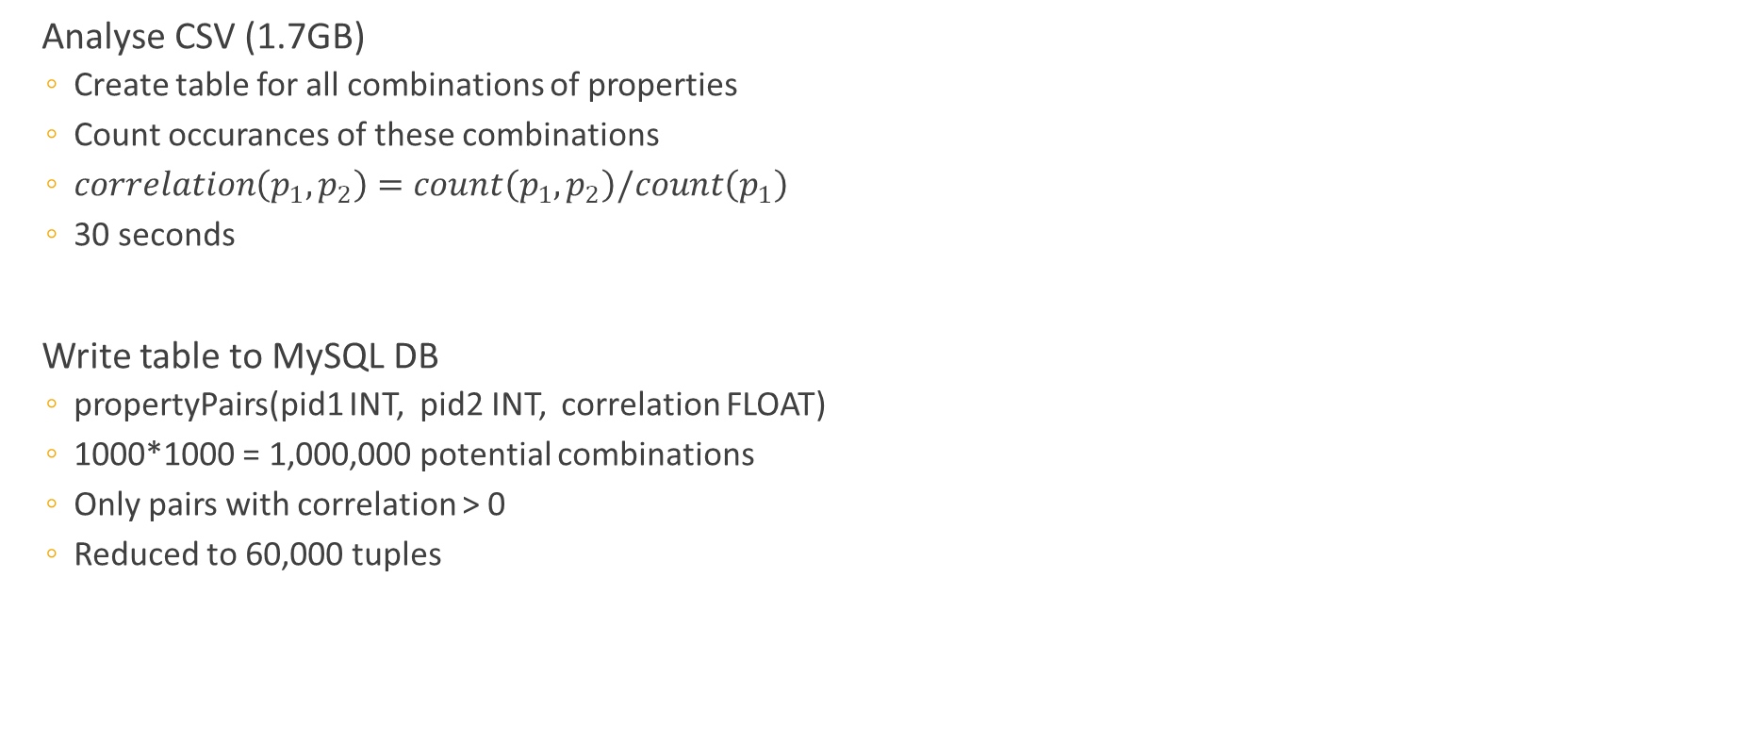
Workflow
XML/JSON Dump
Feature CSV
PHP Suggester
Suggestions
Dump parser
MySQL Table
Calculate Correlations
Analyse CSV (1.7GB)
Create table for all combinations of properties
Count occurances of these combinations
$correlation\left(p_{1},p_{2}\right)=count\left(p_{1},p_{2}\right)/count\left(p_{1}\right)$
30 seconds
Write table to MySQL DB
propertyPairs(pid1 INT, pid2 INT, correlation FLOAT)
1000*1000 = 1,000,000 potential combinations
Only pairs with correlation > 0
Reduced to 60,000 tuples
Notes:
head of government (P6)
shares border with (P47)

Slide 16
Workflow
XML/JSON Dump
Feature CSV
PHP Suggester
Suggestions
Dump parser
MySQL Table
Calculate Correlations
MySQL Table
propertyPairs(pid1 INT, pid2 INT, correlation FLOAT)
Provide Suggestions
Input: an Entity E
$L = list of properties of E
$threshold = minimum correlation
$size = count($L)
SELECT pid2, sum(correlation)/$size AS cor FROM propertyPairs WHERE pid1 IN $L AND pid2 NOT IN $L GROUP BY pid2 HAVING sum(correlation)/$size > $threshold ORDER BY cor DESC LIMIT $limit

Slide 17



Development Process
Repository: Github
Feature-Branches
Pull requests
Reviews
Continuous Integration: Travis
Test coverage: Coveralls
Python: 88%
PHP: 90%

Slide 18


